Slide 3
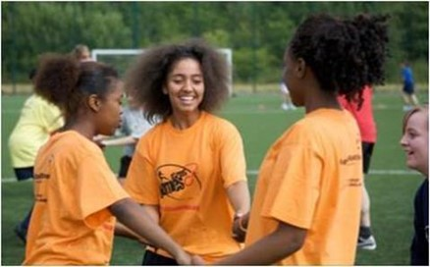
Listening to the Network
How?
Conversations with Over 280 LTOs
On-line surveys & virtual focus groups with 188 young people
Virtual Round Tables with Project Leaders & young volunteers
Why?
To listen
To support
To Advocate

Slide 4
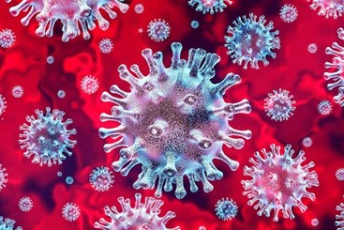
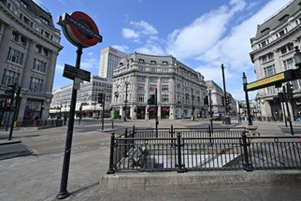
Coronavirus Pandemic
The Coronavirus pandemic & Lockdown restrictions have impacted everyone
But the lived experiences of the crisis is recognized as harsher in low-income areas than in more affluent

Slide 5
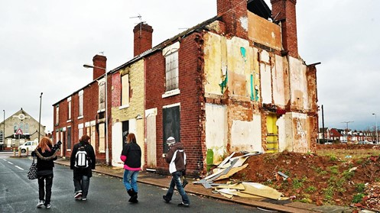
Financial Impact
Nearly one-third of lower-paid employees have lost jobs or been furloughed as a result of the crisis.
Only one-in-ten top earners have been similarly affected.
Notes:
Source: Resolution Foundation Report 2020

Slide 6
Higher Death Rates
Notes:
Source: ONS 2020

Slide 7
Lower Levels of Physical Activity
In the past week, do you think you have done more, less or the same amount of physical activity and exercise, compared to a typical week before the COVID-19 restrictions were introduced?
Notes:
Source: Sport England 2020

Slide 8
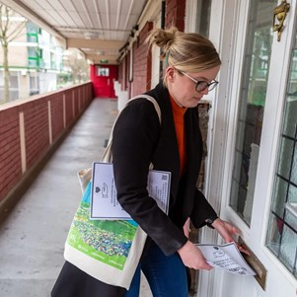
LTOs
LTOs are doing their best to support their communities
Often working with whole families
Concerns are high around well-being

Slide 9
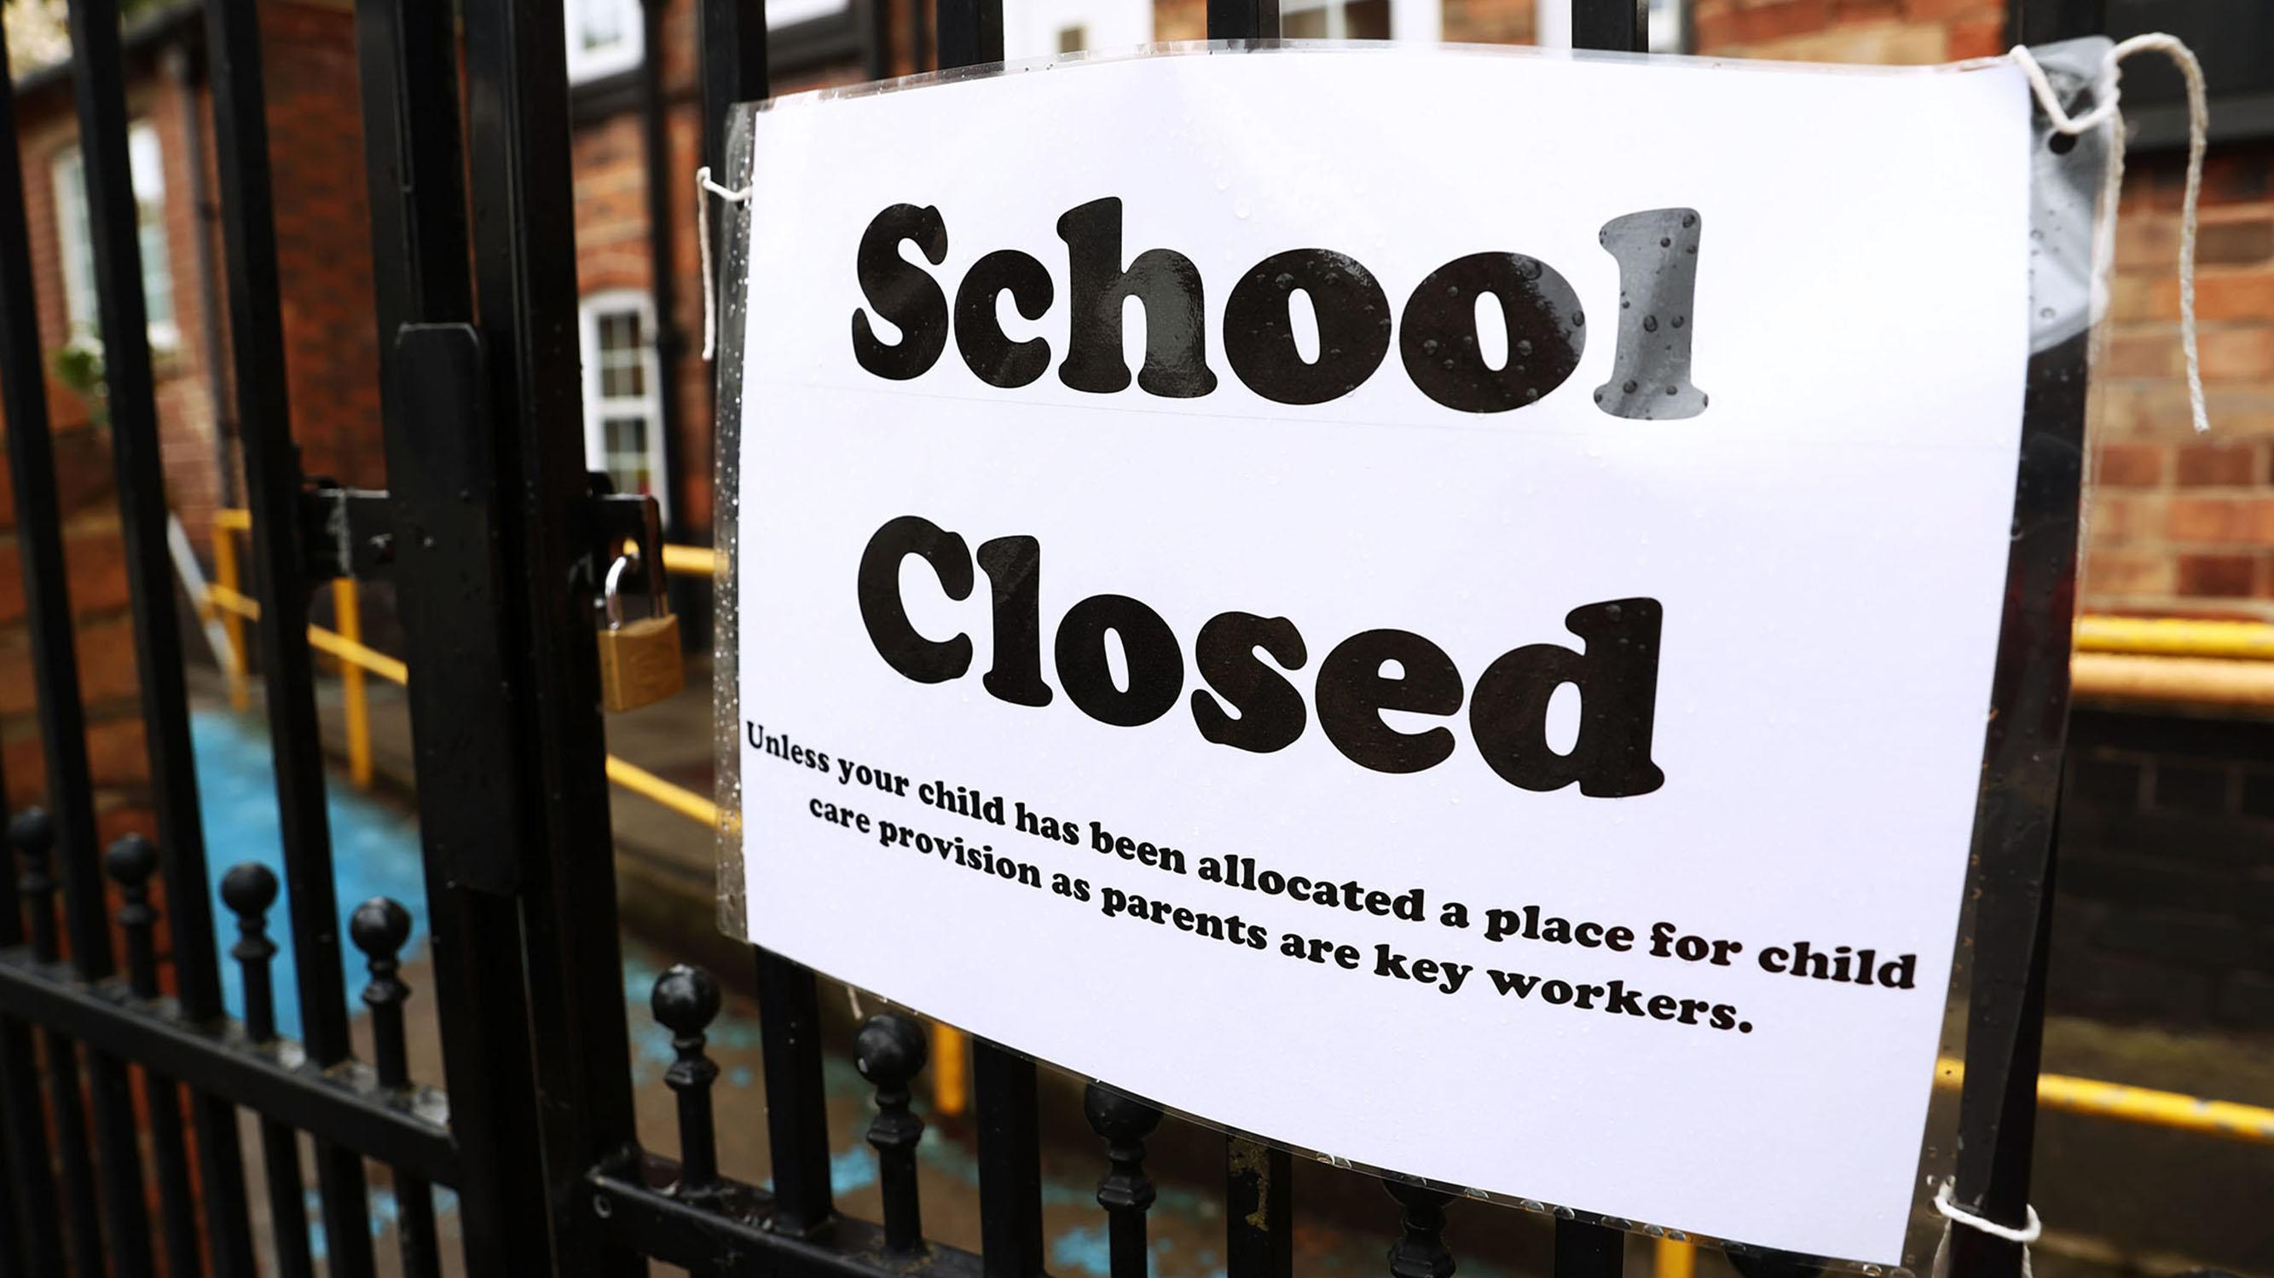
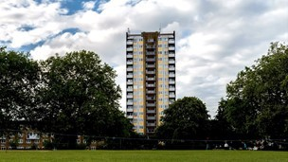
What is happening on the ground?
Young people’s experience of lockdown life
Challenging home conditions
Disrupted routine
Missing friends / socialising
Boredom
Limited private space
Limited access to the internet / shared devices

Slide 10
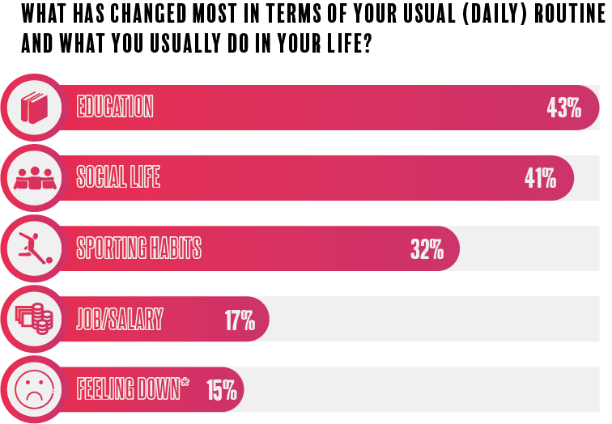
What has changed most for young people?

Slide 11
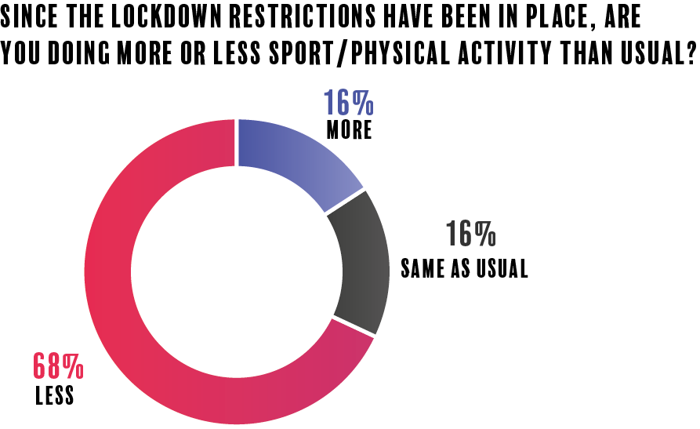
Sport & Physical Activity

Slide 12
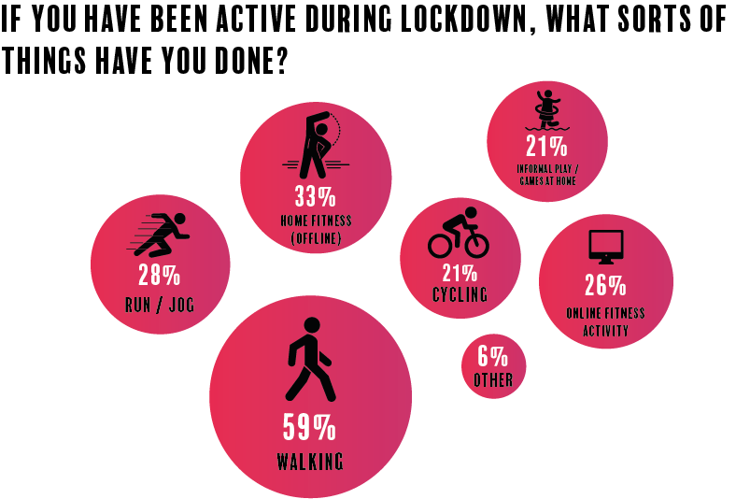
How are young people being active?

Slide 13
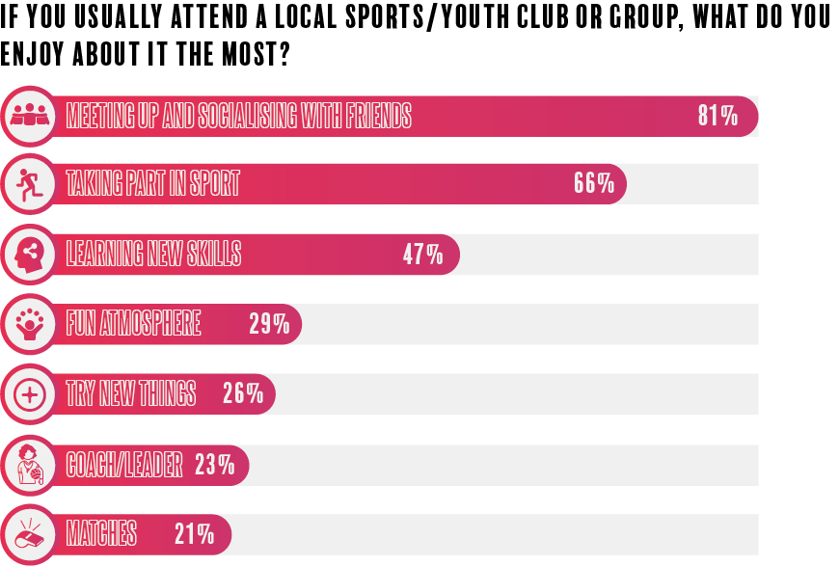
Young people are missing doorstep sport

Slide 14
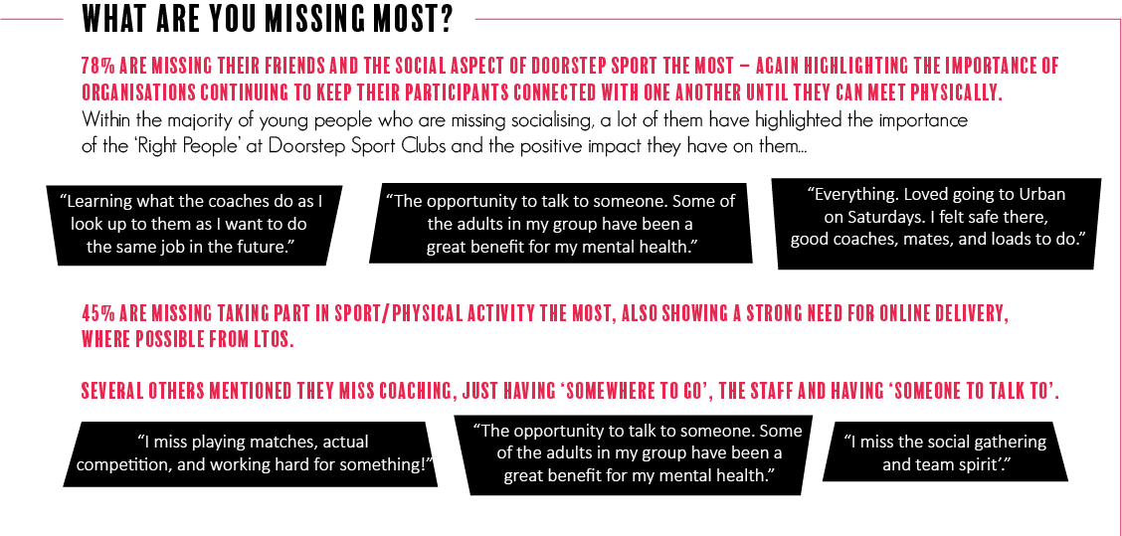
Young people are missing doorstep sport

Slide 15
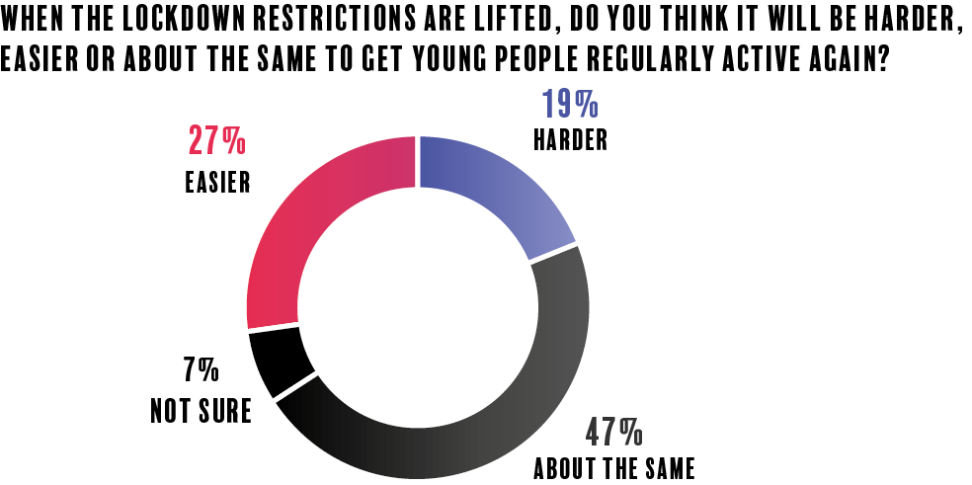

Slide 16
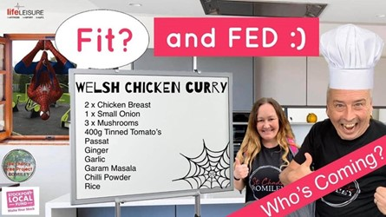
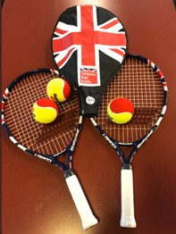
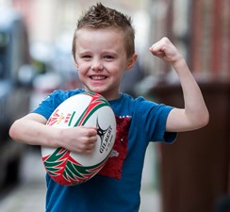
LTOs have changed their priorities & their way of working
Supporting entire families
Food delivery
On-line engagement & activities
Activity packs & sports kit
Mentoring

Slide 17
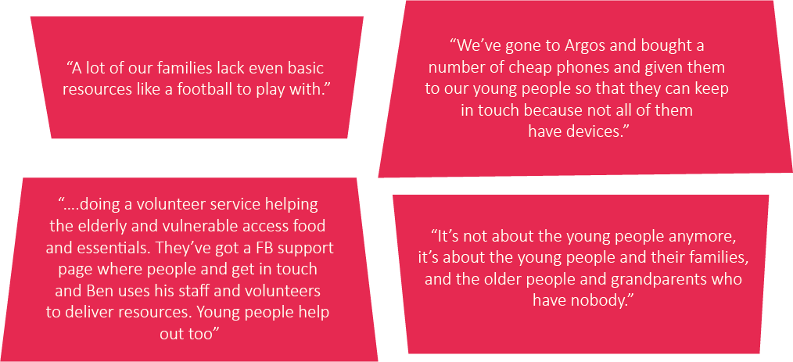
How LTOs are supporting in their communities
“A lot of our families lack even basic resources like a football to play with.”
“We’ve gone to Argos and bought a number of cheap phones and given them to our young people so that they can keep in touch because not all of them have devices.”
….doing a volunteer service helping the elderly and vulnerable access food and essentials. They’ve got a FB support page where people and get in touch and Ben uses his staff and volunteers to deliver resources. Young people help out too”
“It’s not about the young people anymore, it’s bout the young people and their families, and the older people and grandparents who have nobody.”

Slide 18
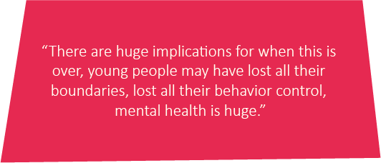
Mental Health & Wellbeing
Deteriorating mental health and wellbeing
Lockdown & fears around the virus
Trauma
Social isolation & loneliness
Stress
Bereavement

Slide 19
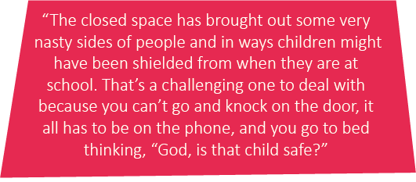
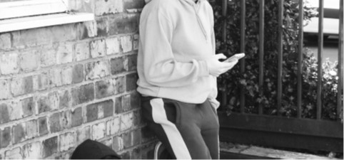
Family Breakdown
Increased Concerns
Isolated families
Increased tensions
Financial hardship
Some are known to be in violent relationships

Slide 20
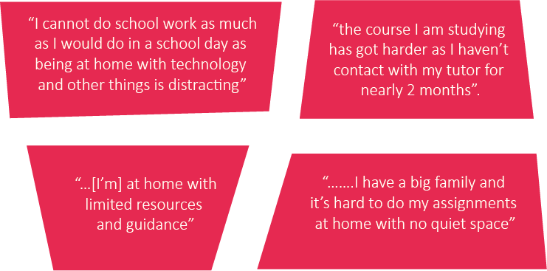
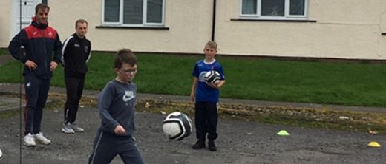
Lack of structure for young people & loss of mojo
Lack of structure
Closure of schools & colleges
Cancellation of exams
Concerns around Job prospects
Missing out on connections with positive role models
Feelings of lethargy

Slide 21
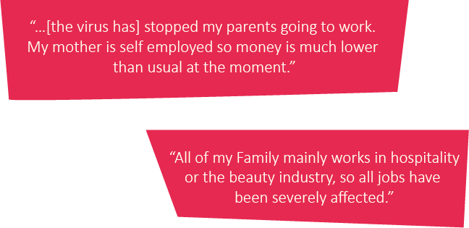
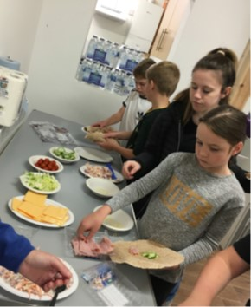
Financial pressure on Families
Financial pressures:
Many families struggling financially
Navigating support structures & systems
Some difficulties accessing FSM vouchers
Concerns for summer holiday period

Slide 22
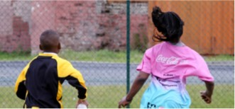
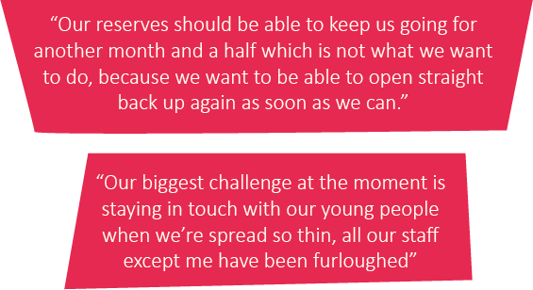
Pressures on LTOS through the crisis and beyond
LTOs report that their whole structure, finances and the activities they provide, are hurt by the pandemic.
At a time when they are facing increased demands
Funding is a major source of concern
Challenging to secure long-term funding

Slide 23
Support Needs
Direct investment and help to fundraise
Opportunities to share ideas & approaches
Space to be listened to
Practical & personal support
National & local level advocacy
Training & support for staff and volunteers

Slide 24
Questions
Any questions /points of clarification?
Does the feedback from LTOs & young people in the report resonate with you?
Have you heard other views & challenges?
Are things starting to change – are thoughts moving towards the next phase?
Any other key areas of support?
Next steps…..

