Slide 1
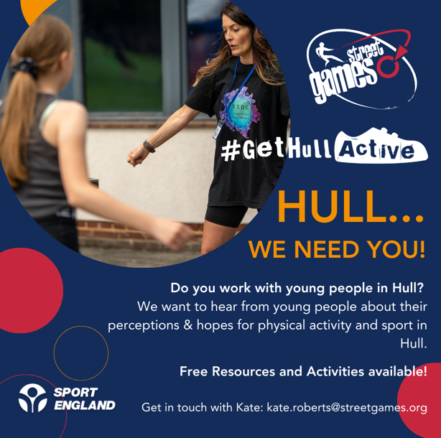
Feedback Session

Slide 2

Hull – Active Listening with Young People
What has happened so far……
Discussion Groups with young people (final numbers TBC)
Xx Led by LTOs
Xx Led by StreetGames
Xx led by Peer Researchers
500 Completed Surveys
Feedback Activities:
Barriers & Motivations
Light bulbs
Hands
Today’s Session
Share initial findings & feedback
Hear your reflections
Check & Challenge
Hear ‘stories’

Slide 3
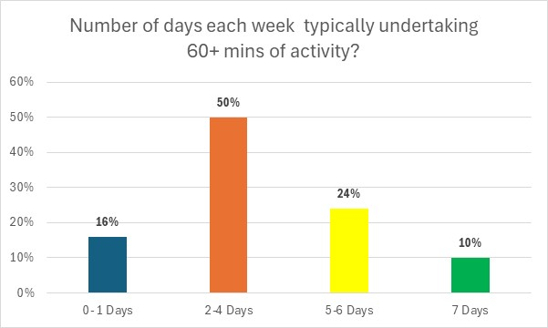
Physical Activity
Young People’s opinions about what ‘counts’ as physical activity:
Some had a clear understanding, but some were unsure:
Felt it had to be ‘traditional sport’
Or had to be cardio fitness/sport
Some ‘surprises’ at what ‘counts’:
Walking
Some were surprised at the levels required to meet CMO guidelines
Current Activity Levels
Most (90%) are not currently active enough to meet CMO guidelines
Around half want to be more active – but some showed little interest

Slide 4
Benefits /Reasons to be active…
Motivations
Social Aspects
Having fun (50%)
Being with friends (38%)
Making new friends (34%)
Improve social skills (28%)
Health & Wellbeing
To improve health/fitness (66%)
To feel good (33%)
To improve body image (24%)
To improve mental health (23%)
Personal Development
To improve skills (42%)
To improve performance 28%)
To compete 21%
I enjoy the social aspects..it’s fun
Informal…relaxed
Want to improve strength & body shape
Helps to escape worries
Sense of relief – to eat ‘guilt free’ once exercised
Enjoy being part of a team..belonging

Slide 5
STOP AND PAUSE
Hear your reflections
Check & Challenge
Hear ‘stories’

Slide 6
Ways to be active…
What they enjoy / would like to do?
Informal Activities
Walking / walking the dog
Riding bike
Play
Sports
Football, rugby, netball, tennis, table tennis
Mult-sports
Wheelsports
Boxing
Fitness/Gym
Dance
What is it that they like about these activities?
Good for my mental health
Socialising
Spending time with my mates

Slide 7
Places to be active…
Need to improve the facilities in Hull
Where they would like to be active:
Parks
Leisure Centres
School/College
Gym
Sports Club
Swimming pools
Youth Clubs
Outdoors/countryside
There was not much ‘appetite’ to be active at home or on the local roads/ pavements
Concerns over high crime rates…parks feel unsafe
Feeling self conscious in kit on the roads/pavements
Age restrictions at the gym

Slide 8
STOP AND PAUSE
Hear your reflections
Check & Challenge
Hear ‘stories’

Slide 9
Key Barriers
What stops you being more active?
Psychological Factors
Lack confidence (39%)
Too anxious (27%)
Too self-conscious (27%)
Not ‘sporty’ (15%)
Physical Factors
Not able to get there (19%)
Can’t afford it (16%)
Don’t know what’s on in the area (19%)
Individual Factors
Lack of time (40%)
No-one to go with (32%)
Lack of energy (37%)
Motivational Factors
Prefer to do other things (16%)
Don’t enjoy sport (15%)
Just don’t like exercise
Would need an ‘incentive’
No idea what’s on
Because of school buses – can’t stay behind
Needs to be less Competitive
Other people Judging

Slide 10

What needs to change ?
Time – Having less homework
Motivation – Provide incentives
Fear of Judgement – More informal opportunities, including ‘social’ time, clothing
Feeling self-conscious – Less ‘sporty’ leaders, girls only sessions
Can’t get there – Better transport
Cost – Offer discount/free passes for young people to leisure centres
Safety Concerns – Better lighting, maintenance & activation of parks
Lack of awareness – More targeted information for young people

Slide 11
STOP AND PAUSE
Hear your reflections
Check & Challenge
Hear ‘stories’

Slide 12
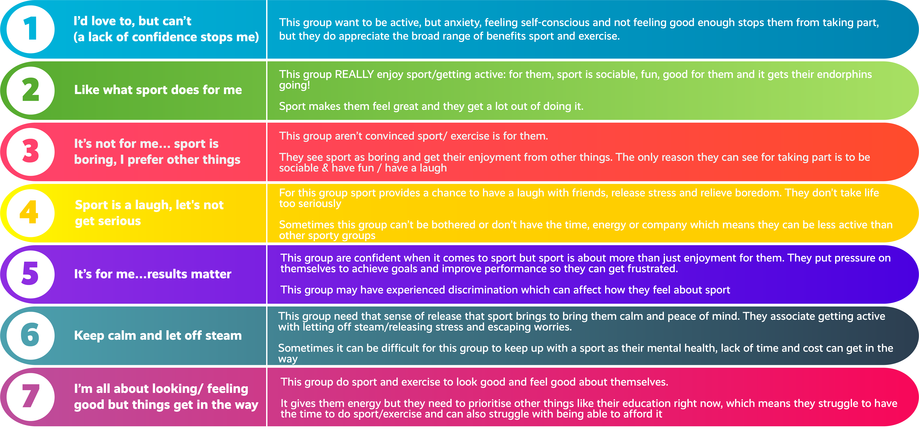
Youth Segments (from the Survey)

Slide 13
Not one homogenous Group
Group | Youth Segments | Considerations
‘Reluctants’ (31%) | 19% Segment 1 – I’d love to but lack confidence 12% Segment 3 – It’s not for me…sport is boring, I prefer other things | Greater intervention & support will be needed. Sport needs a ‘re-brand’ for segment 3 and a supportive approach for segment 1 to be more active
‘The Opens’ (34%) | 21% Segment 4 – Sports a laugh, let’s not get serious 6% Segment 6 – Keep calm & let off steam 7% Segment 7 – I’m all about looking & feeling good | Segments 2, 6 and 7 do take part but for (differing) ‘extrinsic’ reasons & are receptive to initiatives to increase activity levels
Sport Positive & Developers (35%) | 17% Segment 2 – Like what sport does for me 18% Segment 5 – It’s for me, results matter | Segments 2 and 5 are active & sport positive but their future participation relies on developing opportunities for lifelong participation.

Slide 14
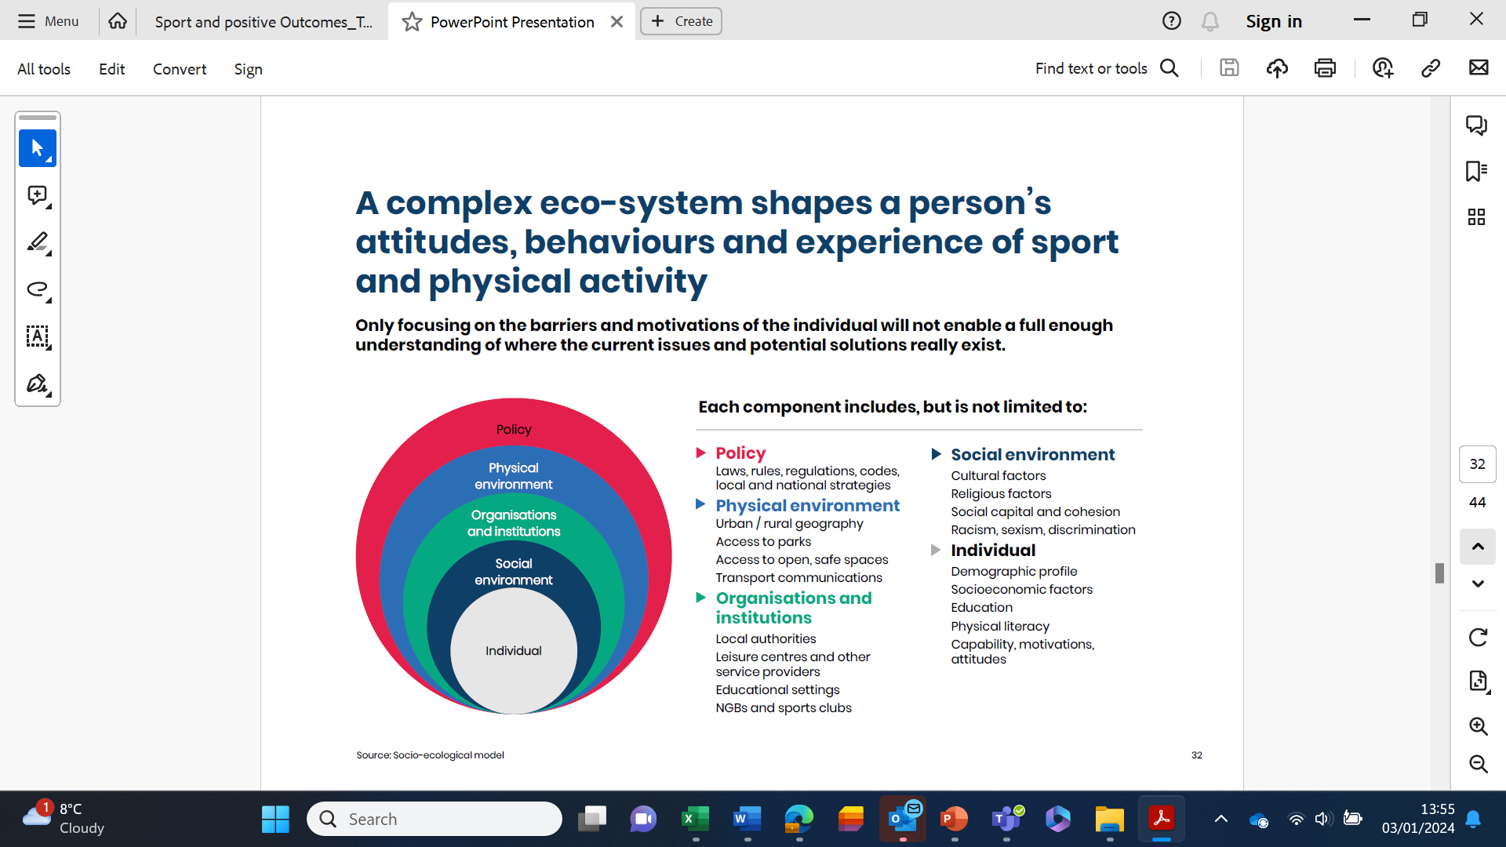
Audience & Influence
Are there other changes and ‘adjustments’ which young people shared are needed in their local area to (using these different ‘layers’)
Are there some young people who might be interested in sharing their views with key organisations and partners locally to help influence change. (Asking those organisations to think about how they can help change things in their part of the ‘system’)
Notes:
Emily - Tees Valley example

Slide 15
What next ?
Refinements
Bringing the data to life
INFLUENCE
Where to share ?
How to share ?
Who to share ?
What influence do we want?

