Slide 1


Slide 2
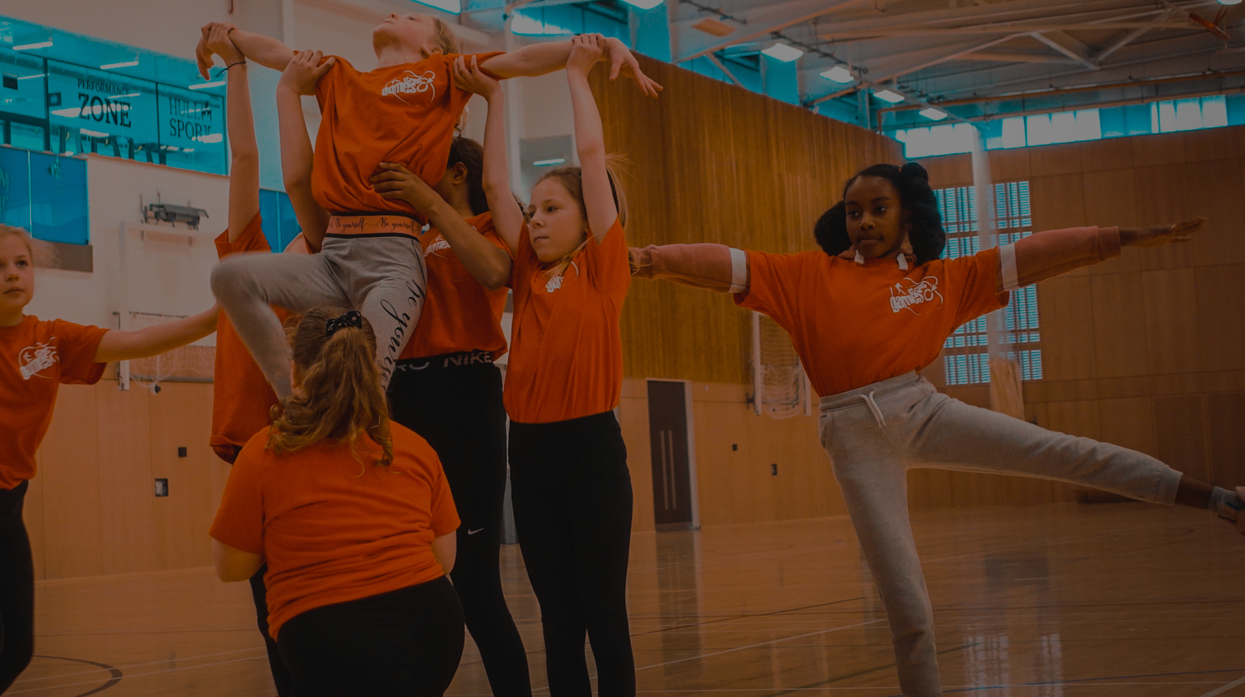
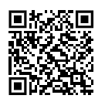
What we were exploring
• Perceptions of physical activity;
• Current activity levels and barriers
• Motivations, ideas and suggestions on what needs to be changed or improved

Slide 3
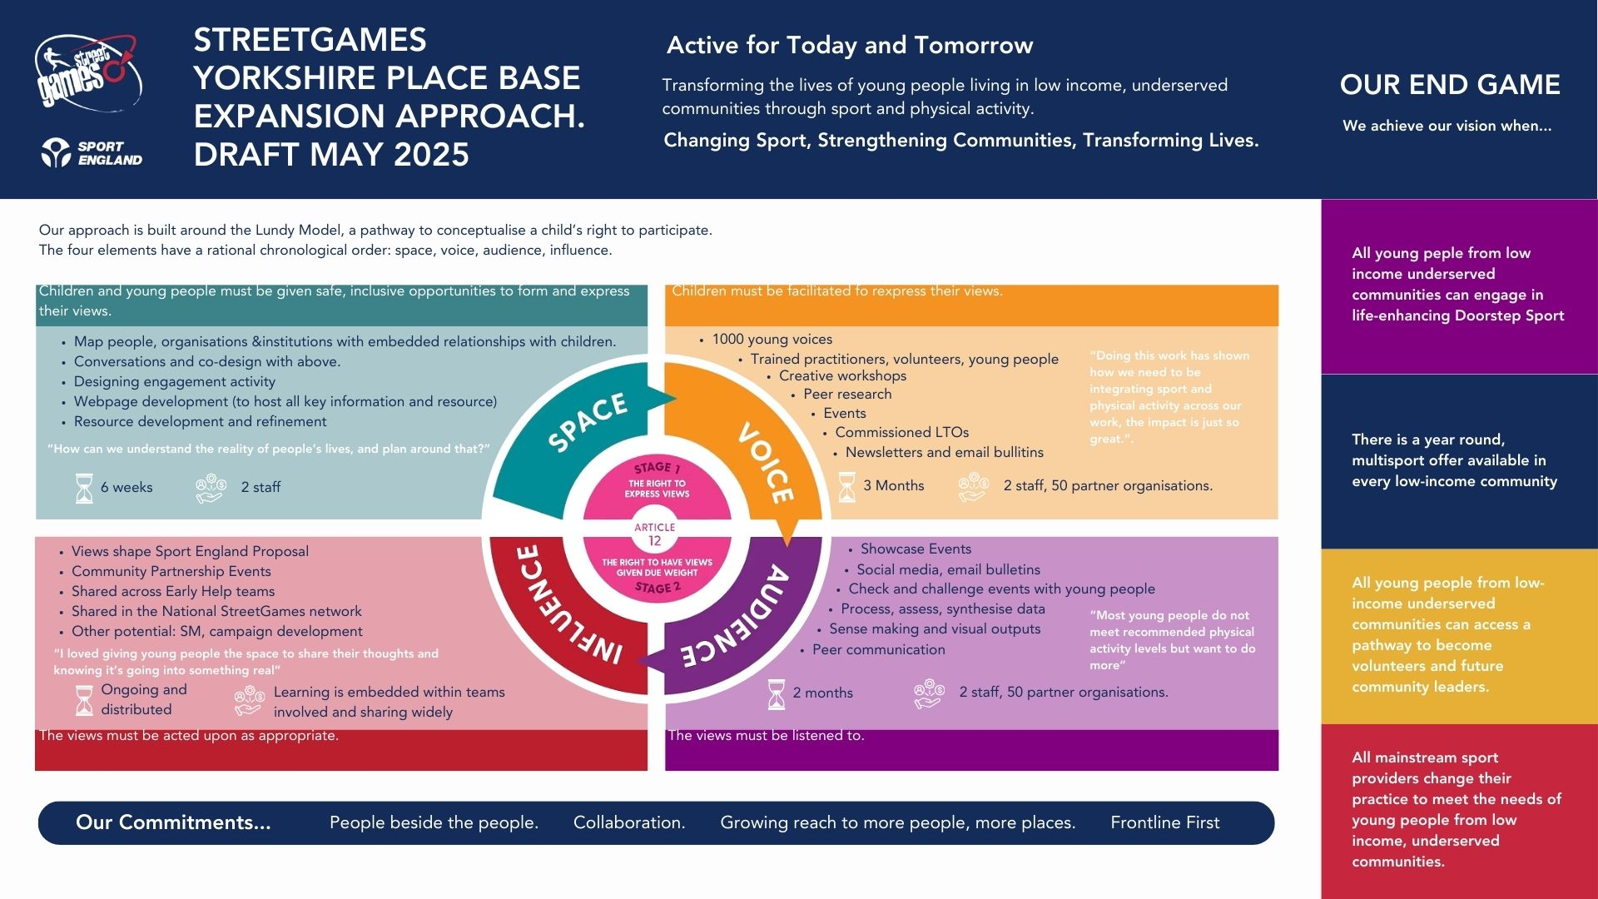
Notes:
Who we are
What and how we approached the work in. Huge recognistion to the system in Hull who have enabled this level and quality of engagement.
Many more than 500 young people participated (we just cannot calculate the exact number)

Slide 4
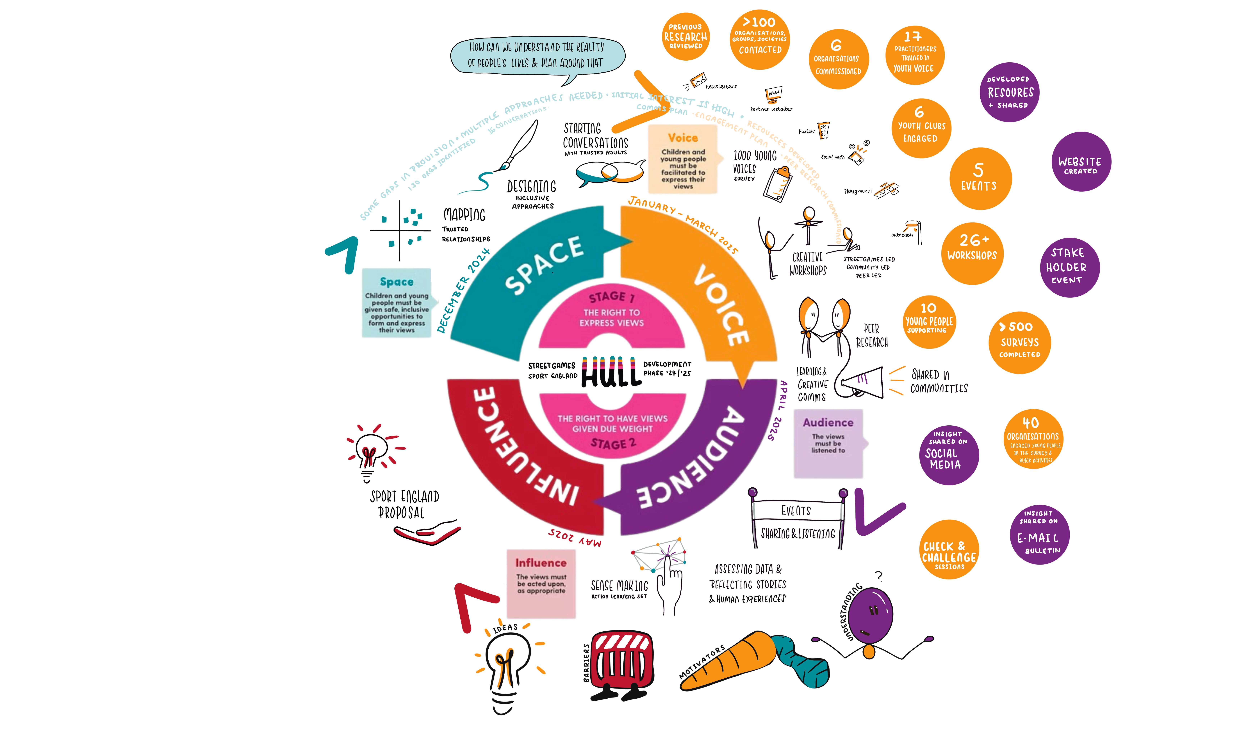
Engagement
Well over 500 young people
500 surveys
26+ workshops
100 unique activities
5 events
6 organisations commissioned
Other research reviewed
Check and Challenge sessions

Slide 5
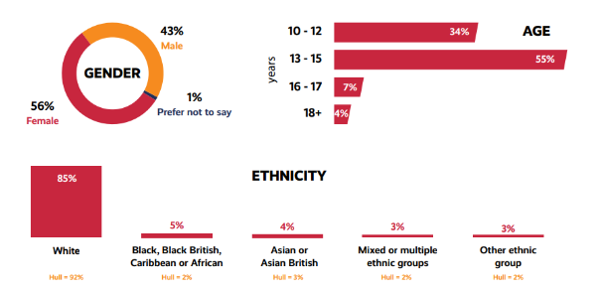
Who engaged
90 % of young people we spoke to are not currently active enough to meet CMO guidelines

Slide 6
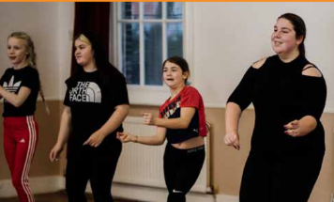
Perceptions of Physical Activity
Some young people had a broad understanding of what physical activity is and how active they ‘should be’
Many were surprised at the broad range of activities that counted as physical activity
Many were surprised they ‘should’ be doing 60 minutes of physical activity per day
50 % of young people would ‘like to be more active’ , however many of the least active ‘had no desire to increase physical activity’

Slide 7
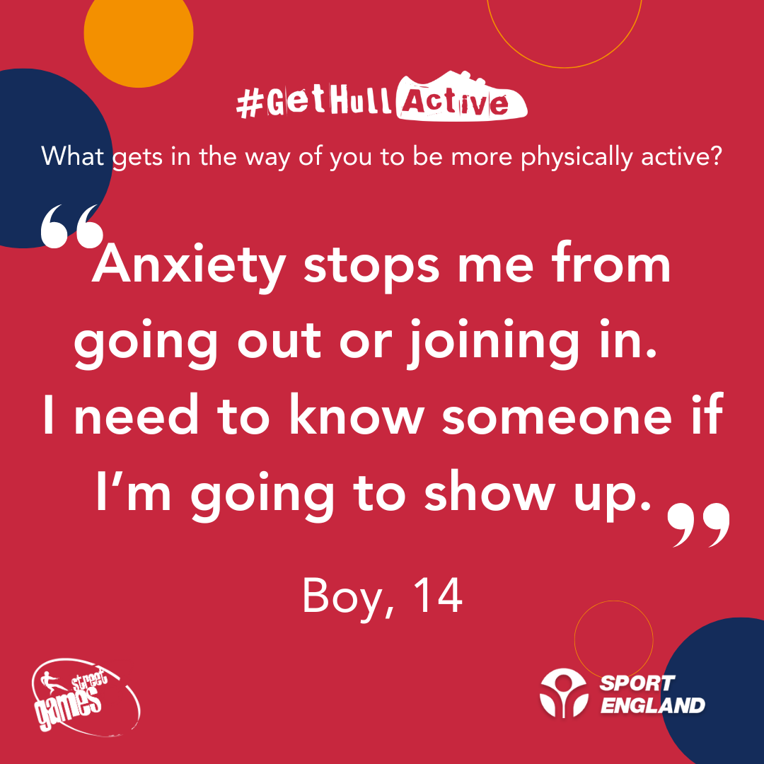
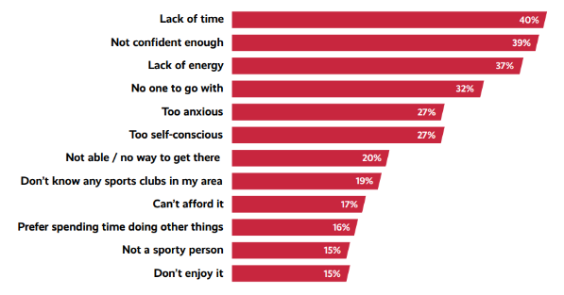
Barriers
Individual Factors (Lack of time)
Psychological Factors (Not confident enough)
Motivational factors (lack of energy)
Physical factors (cost / transport)

Slide 8

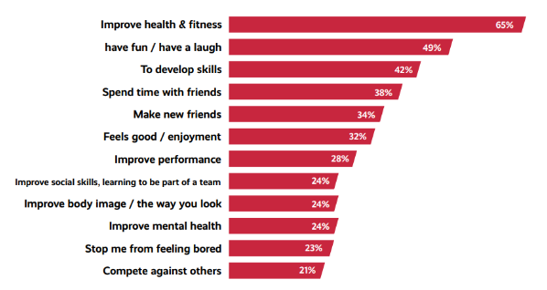
Motivations

Slide 9
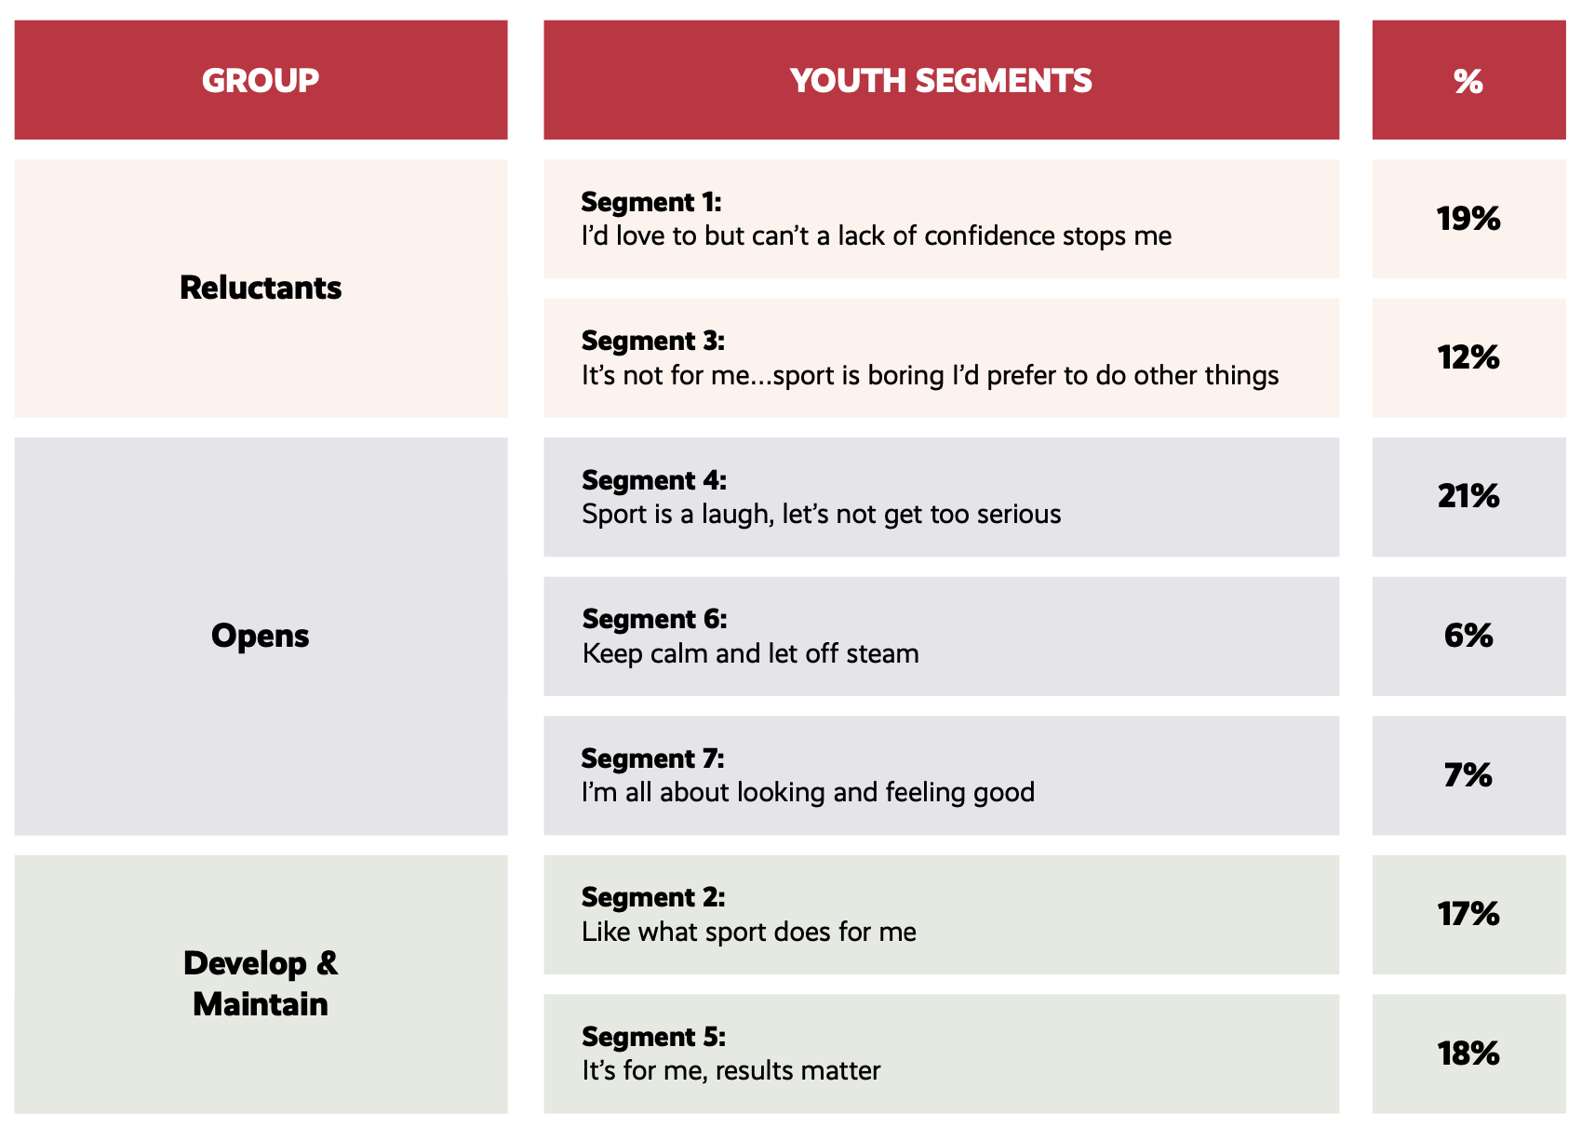
Survey Analysis
31%
34%
35%
Notes:
Further understanding around young people’s motivations and types of activities and oﬀers which are most
likely to appeal, was also gained from the survey data.
Data analysis of the responses young people shared in relation to their key barriers, motivations and
emotions they feel when taking part in sport and physical activity, and insight from StreetGames 1,000
Young Voices, provided data re which of the seven Youth Segments the young people most closely align
with – see Table 1 below.

Slide 10
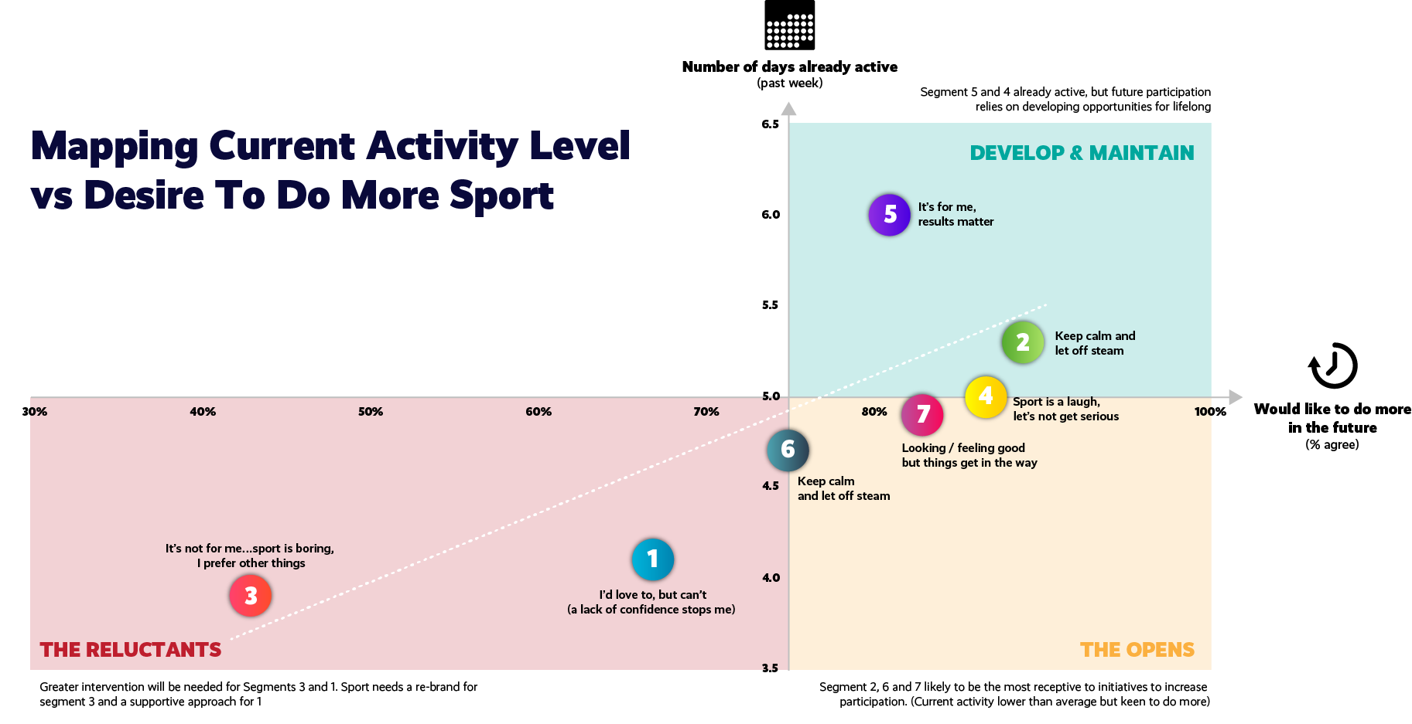
Notes:
The 7 segments can also be ‘grouped’, which is perhaps best illustrated on this graph,
It shows how active the YP are on the vertical (Y axis) so those higher up the axis are currently the most active and
what % would like to do more activity in the future on the horizontal (x axis) so those segments furthest to the right are most likely to want to do more….so we have
Group 1: The Reluctants (bottom left quadrant) which include segments 3 and 1….where interventions are likely to require a supportive approach to appeal
Group 2: The Opens (bottom right quadrant(which includes segments 6 and 7….who are most receptive to initiatives to increase participation, but currently have lower than average activity levels. Segment 4 intersects into the opens and the develop and maintain…- this is a group who are active and want to do more in the future as they enjoy taking part to have fun/ a laugh
Group 3: The Develop & Maintain (top right quadrant which includes segments 5 and 2 (and 4)….they are already active – but for different reasons for segment 4 it’s to have fun/laugh, for 5 it’s about results and competition, for 2 they just enjoy it and what sport does for them, but future participation relies on developing opportunities for a lifelong habit

Slide 11
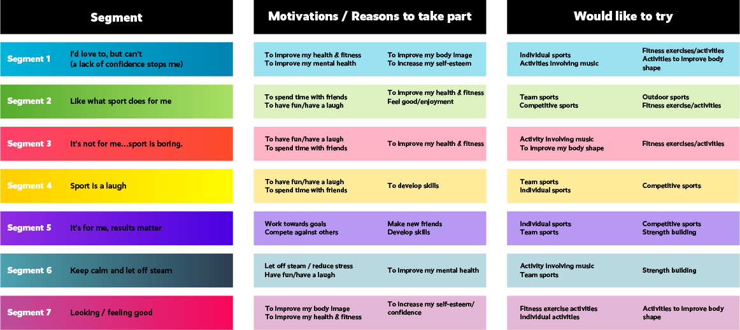
Their motivations & interests are varied

Slide 12
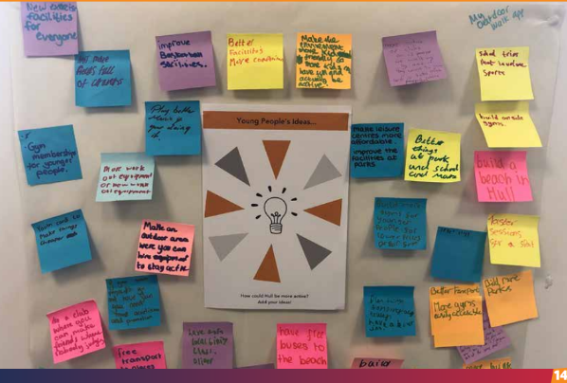
Ideas
Know – how
Safety in public spaces
Incentives / rewards
Embracing technology
Right people

Slide 13
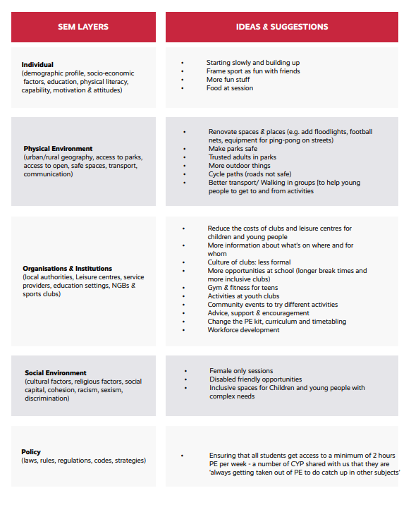
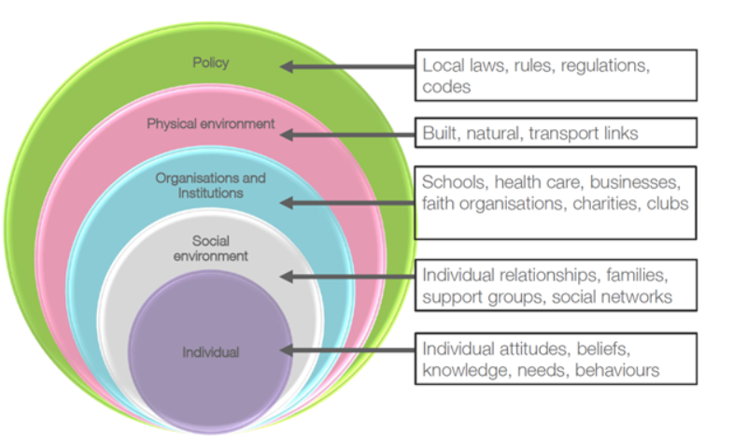
The Onion!

Slide 14
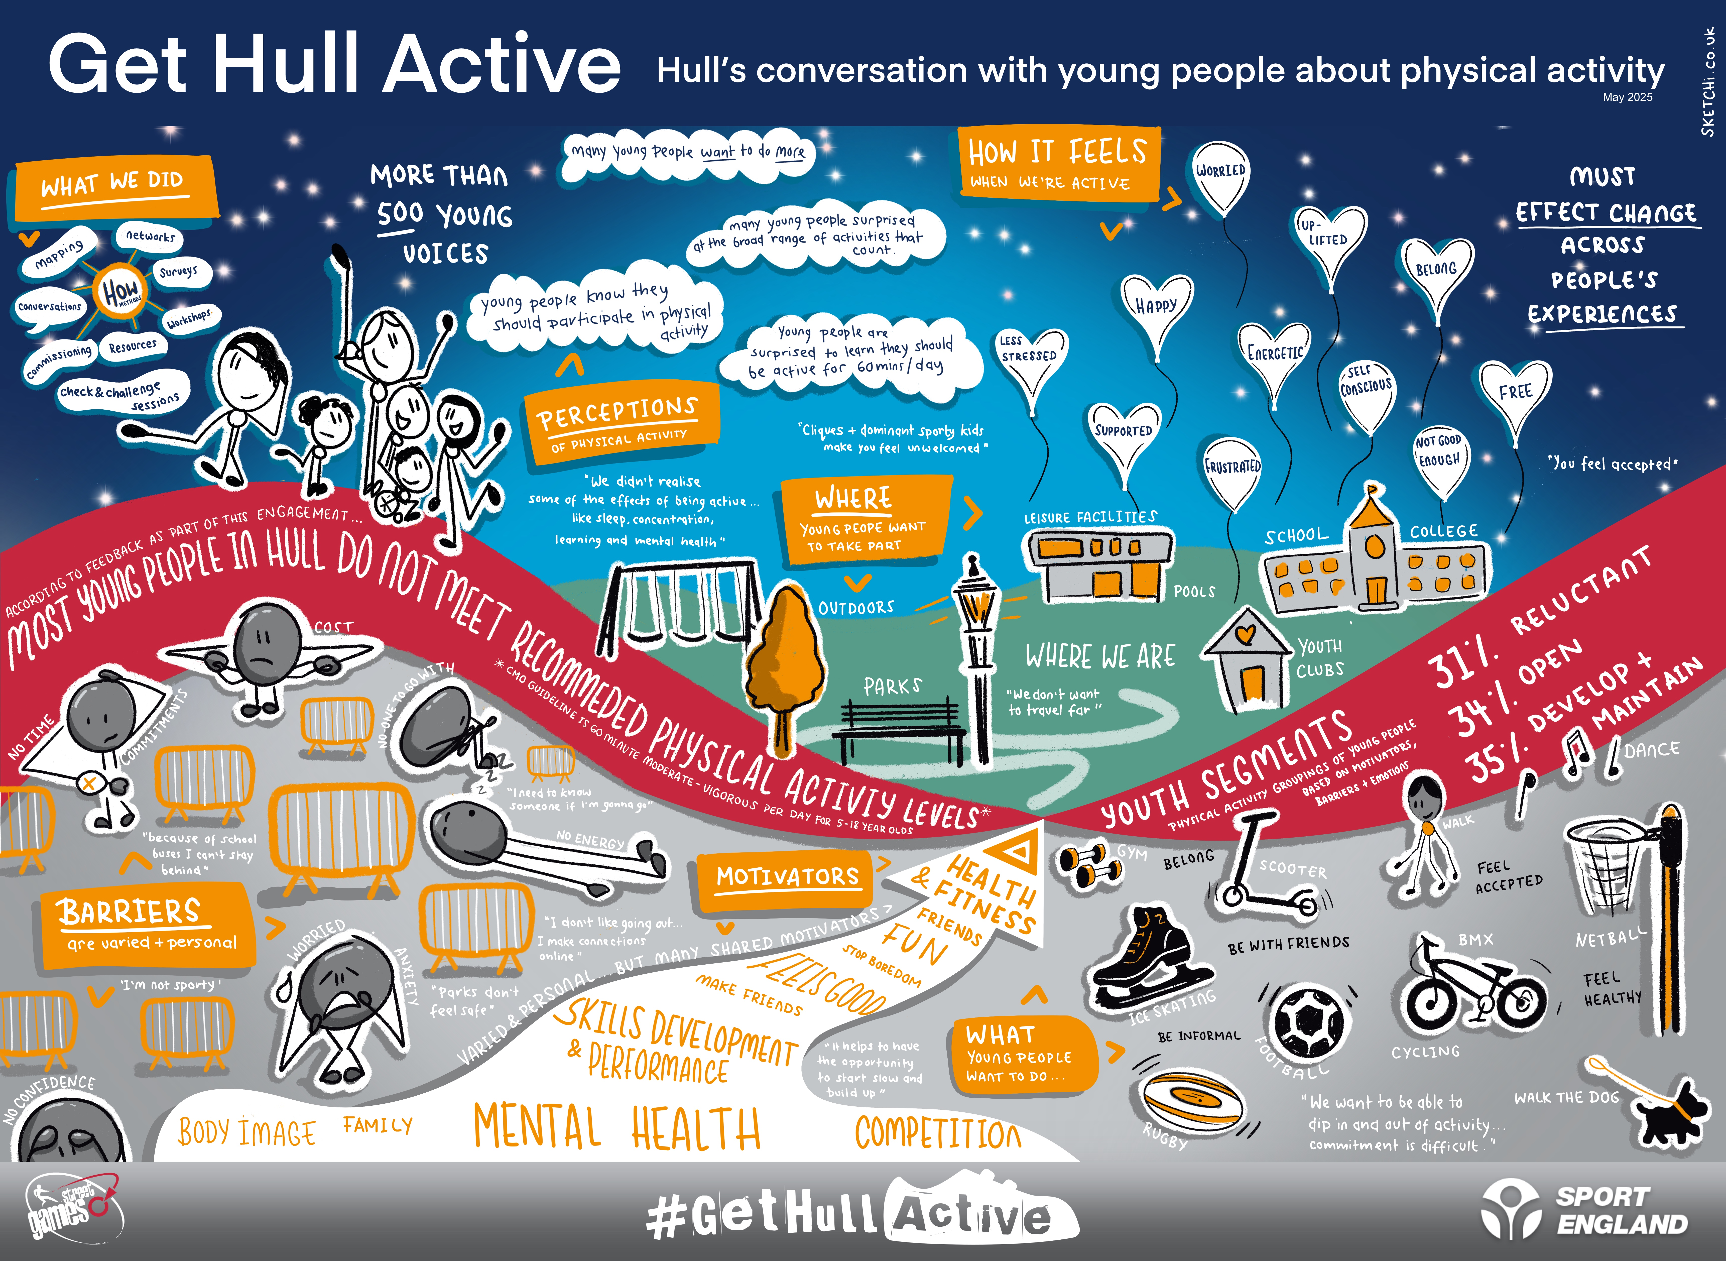

Slide 15
Find out more
All engagement tools are available for you to use and keep the conversation going, all on our website.
The report details what we have outlined.
Contact Kate Roberts, StreetGames Partnership Manager for Yorkshire, Humber and North East. Kate.Roberts@StreetGames.org

Slide 16


